Slide 1
Deterministic Graph Sparsification of Dynamic fractional matching
Guided By:
Dr. Anil Shukla
Assistant Profesor, IIT Ropar
Presented By:
Hanumat Lal Vishwakarma
2021CSM1019

Slide 2
Content
Background
A Common Strategy followed in Recent Literatures
Dynamic Fractional Matching
Problem Statement
First Deterministic Algorithm
Demonstrate with an example
Our Proposed Algorithm
Analysis
Conclusions
References

Slide 3
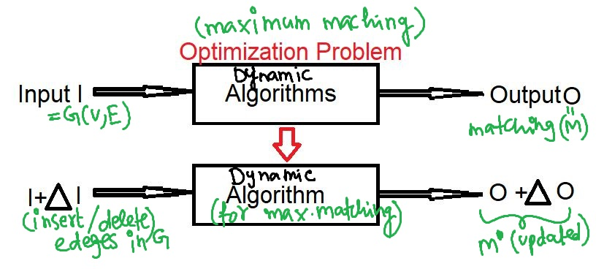
Background
Dynamic Graph Algorithms:- “Preserving graph properties on dynamic graph”
Fig1. Preserving Maximum Matching under edge updation

Slide 4
First thought :
-Re-Apply algorithm from scratch on updated graph
Dynamic Matching Problem under edge updation :-
Want: Maintain graph property “Maximum matching”
Challenge: Graph changes over time as edges are inserted or deleted.
Goal: Design an updation algorithm of the least time complexity that update the maximum matching as edges are inserted or deleted on run-time.
*update time= time taken to handle an update(edge insert/delete)

Slide 5
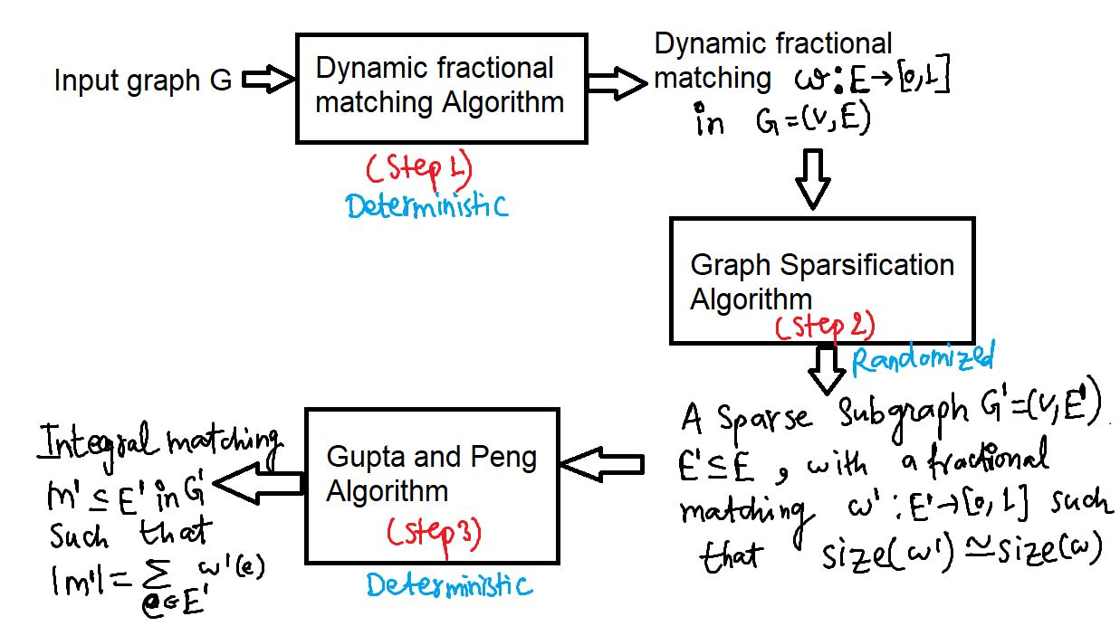
A Common Strategy followed in Recent literatures

Slide 6
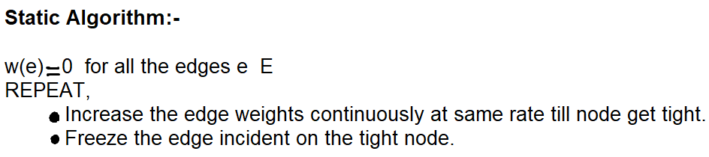
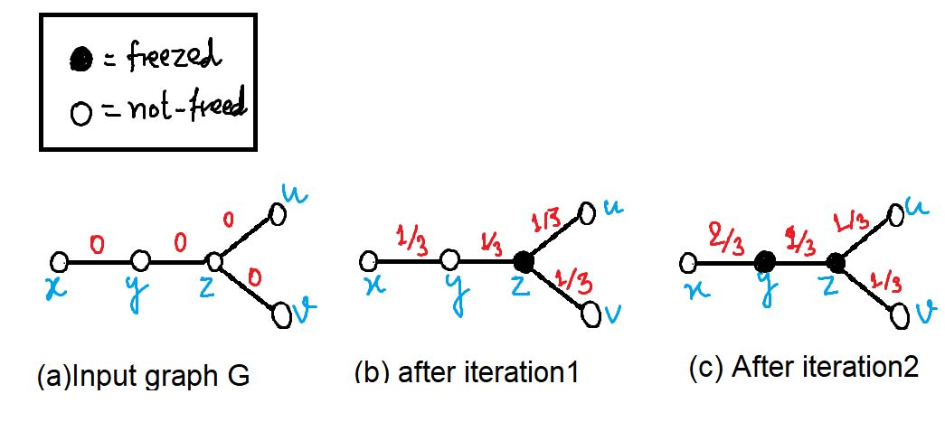
Dynamic fractional matching
Fig2. demonstration in static setting

Slide 7
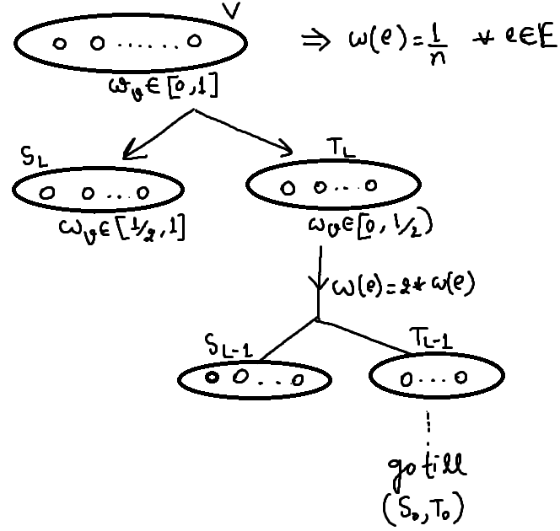
Descretize the algorithm:-(increase edge weight by factor of 2)

Slide 8
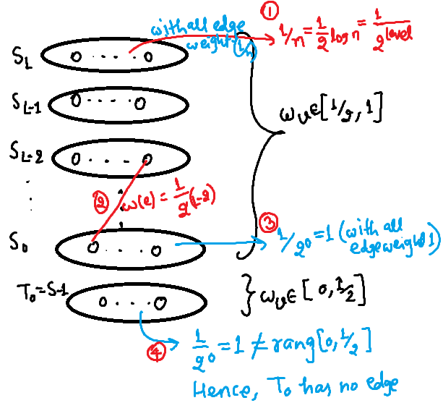
Maintaining Heirarchical partitioning of G:-

Slide 9
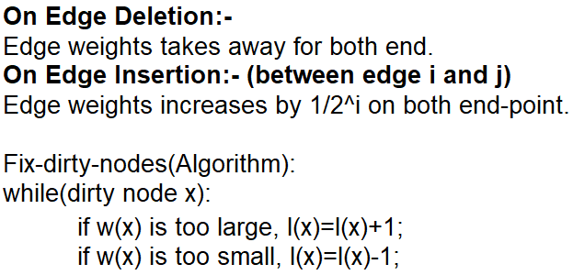
Dynamic Setting:-

Slide 10
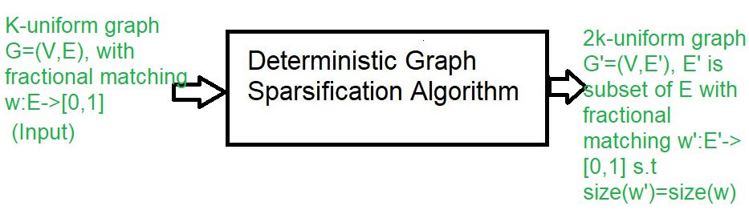
Problem Statement
Input: λ-uniform weighted graph G=(V,E), with fractional matching w: E->[0,1].
Output: 2λ-uniform weighted graph G’=(V,E’), E’ is subset of with fractional matching w’: E’->[0,1] such that size(w’)=size(w), where size(w) is defined as sum of all the edge-weights in graph G.
Fig3. Our Problem statement(step-2 of common strategy)

Slide 11
First Deterministic Solution
Degree_Split() Subroutine:-
Main Idea:-
Size(w)=6
Size(w)=6

Slide 12
Degree-split Algorithm:-
For, Input G=(V,E)
Step 1. Partition E into a set of disjoint maximal walk {W1,W2,…,Wk}
Step 2. for each i: [1,k],
Let Wi*=Collection of alternate edges from Wi.
Step 3. return E’=W1* U W2* …Wk*

Slide 13
Demonstrate with an Example
Let’s demonstrate with an example.

Slide 14
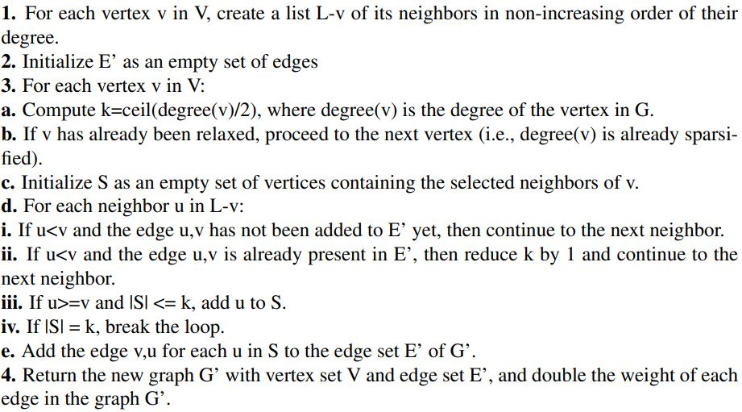
Our Proposed algorithm

Slide 15
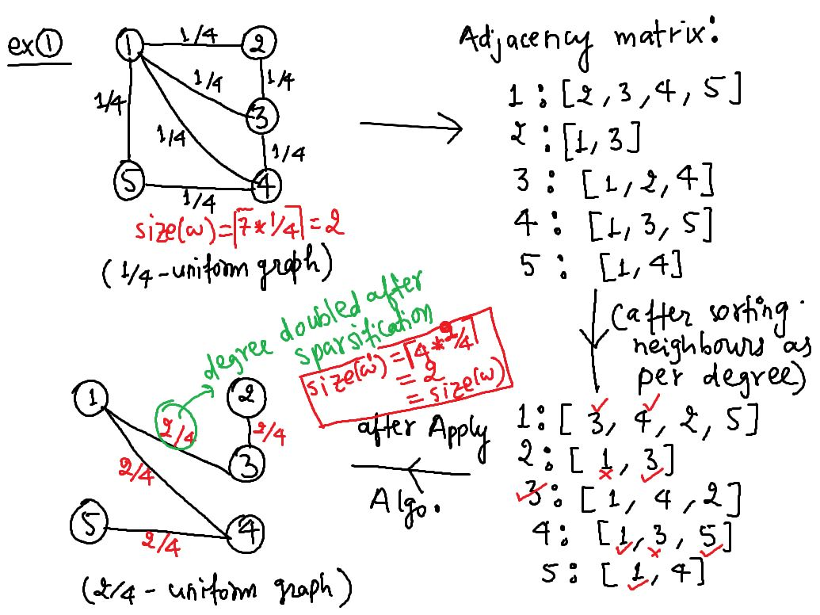

Slide 16
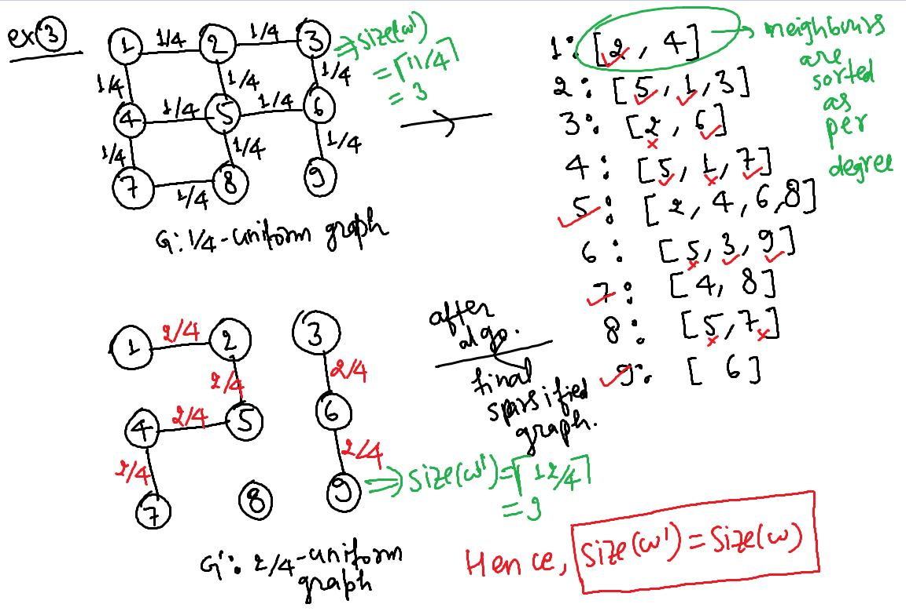

Slide 17
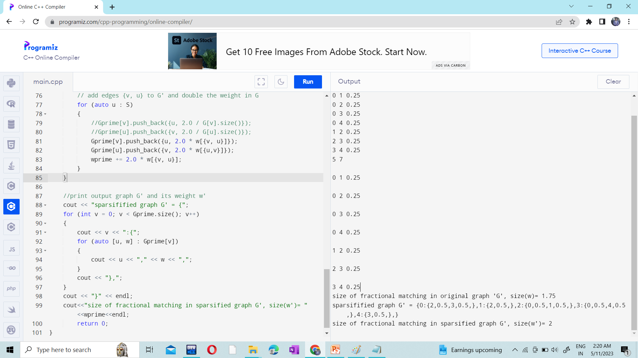

Slide 18
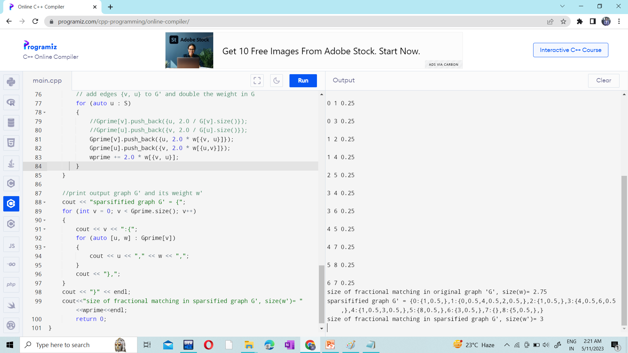

Slide 19
Analysis
Time Complexity: O(E log V)
Space Complexity: O(E)
Implications:-
(1) Derandomize existing solutions.
(2) Create new deterministic solutions for Dynamic matching Problem

Slide 20
Conclusions
Prior Works, Arar et al. [ICALP’18] and David Wajc [STOC’20].
No deterministic solutions before 2021.
Degree-split was first deterministic solution.
Our proposed algorithm is second deterministic solution.
In future, Possibility of more such deterministic solutions and optimization might be possible.

Slide 21
References
Bhattacharya, S., Kiss, P. (2021, May 4). Deterministic Rounding of Dynamic Fractional Matchings. Paper presented at the International Colloquium on Automata, Languages, and Programming (ICALP).
Bhattacharya, S., Kiss, P., Saranurak, T., Wajc, D. (2022, November 9). Dynamic Matching with Better-than-2 Approximation in Polylogarithmic Update Time.
Wajc, D. (2020). Rounding Techniques for Dynamic Fractional Matchings. In Proceedings of the 52nd Annual Symposium on Theory of Computing (STOC).
Arar, M. A., Mastrolilli, M., &Liaghat, V. (2018). General-Purpose Rounding Schemes for Dynamic Fractional Matchings. In Proceedings of the 45th International Colloquium on Automata, Languages, and Programming (ICALP).
Manoj Gupta & Richard Peng(April 11, 2013),Fully Dynamic (1 + ǫ)-Approximate Matchings .
Vazirani, V. V. (2022). Online Bipartite Matching and Adwords.
Karp, R. M., Vazirani, U. V., Vazirani, V. V. (1990). An optimal algorithm for online bipartite matching. In Proceedings of the Symposium on the Theory of Computing (STOC) (pp. 352-358). ACM.

Slide 22
Thank You

